Slide 1
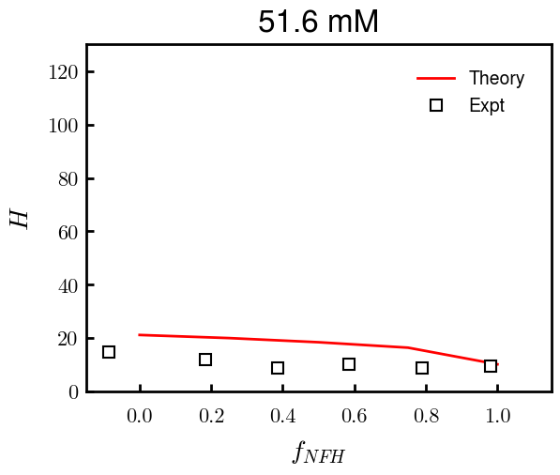
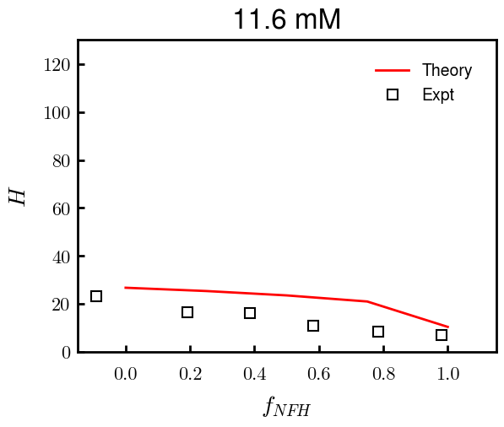
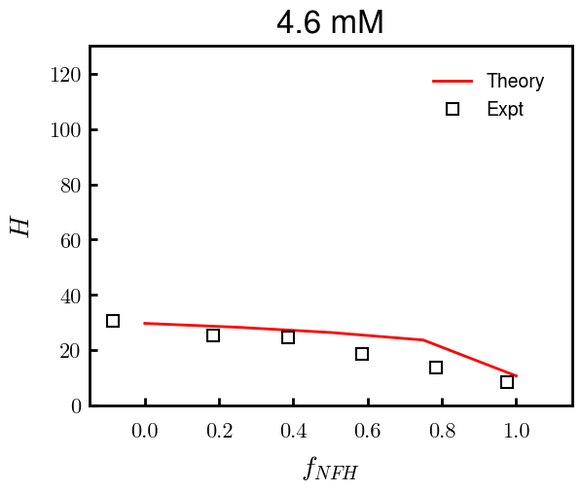
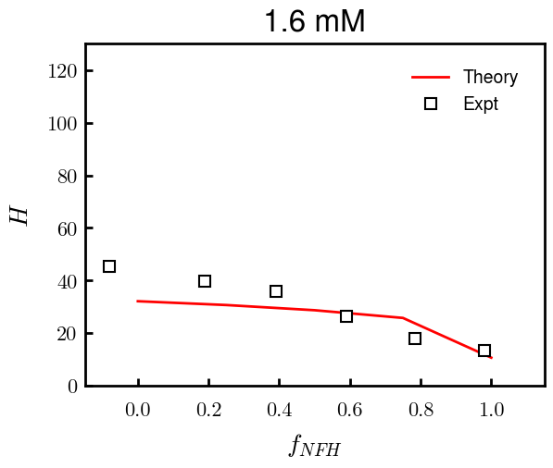
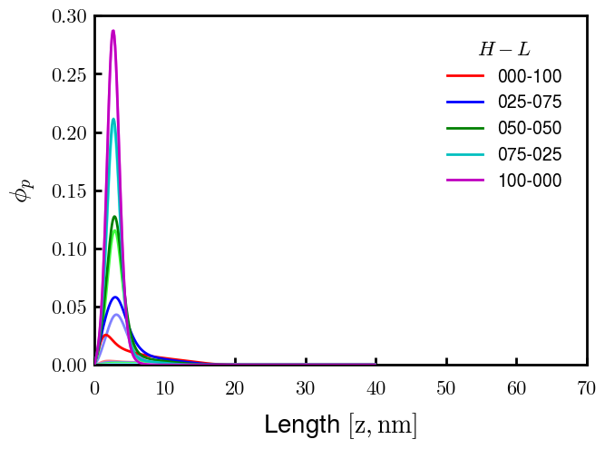
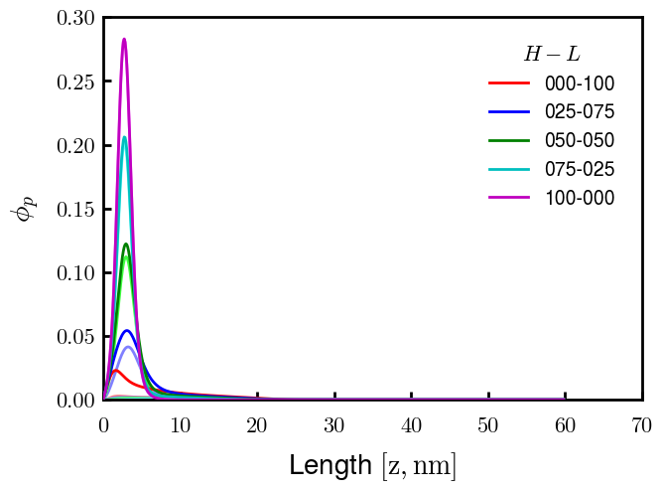
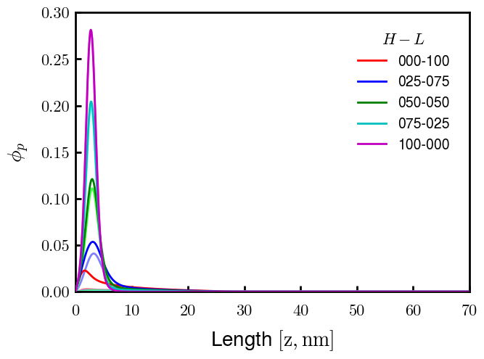

Binary NFH:NFL; sigma_total = 0.0344 c/nm2; bv = (0.6, 0.05)

Slide 2
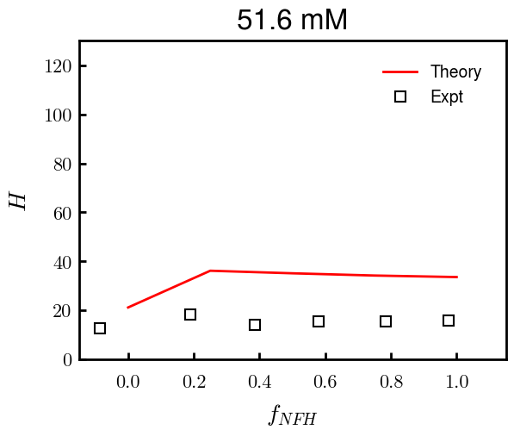
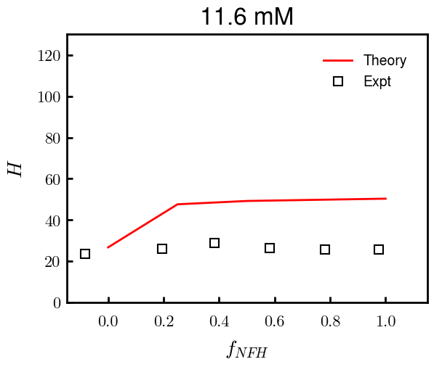
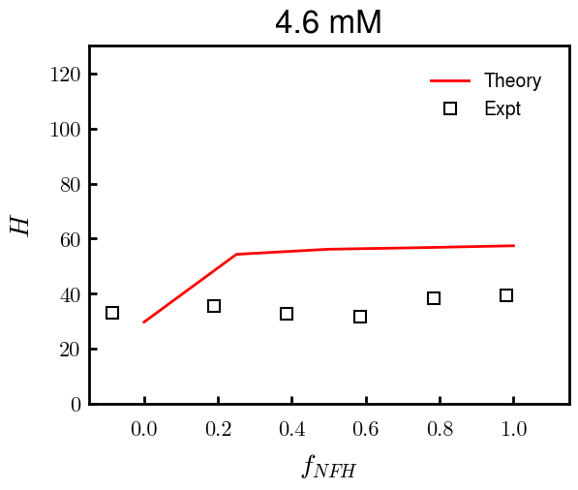
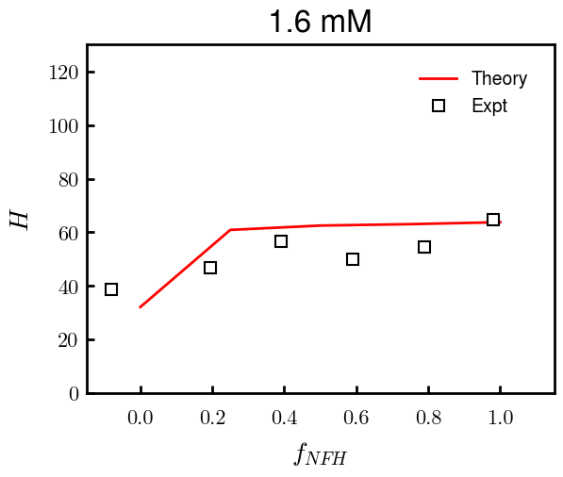
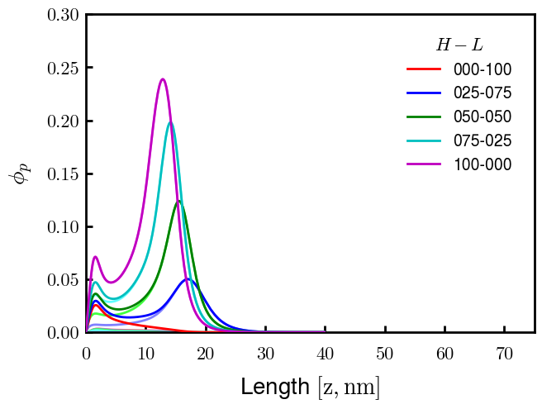
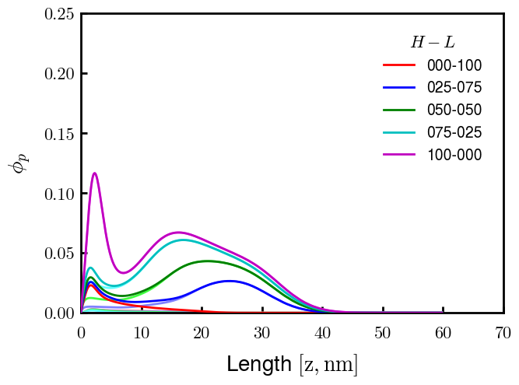
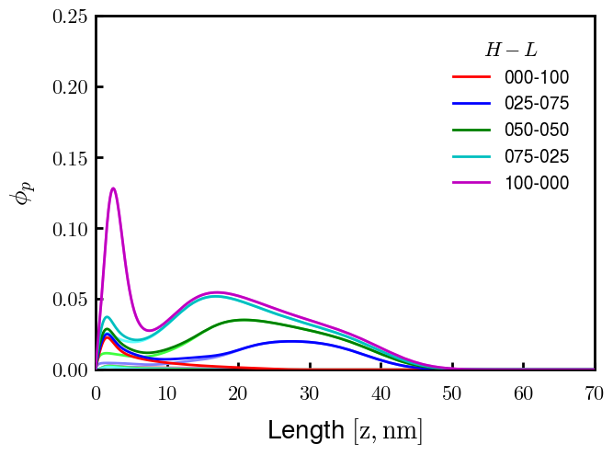
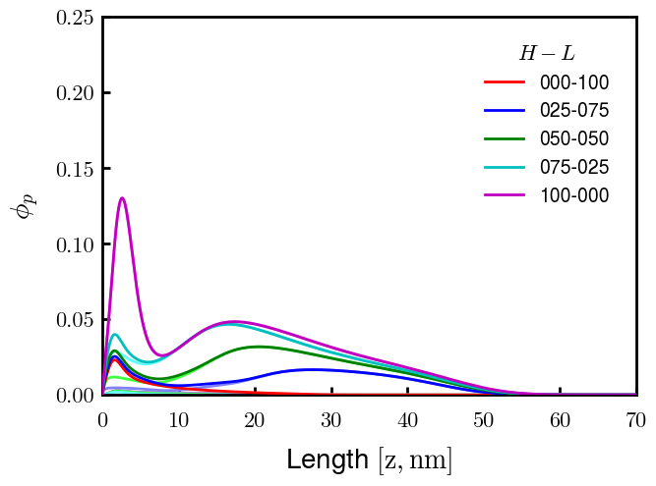
Binary pNFH:NFL; sigma_total = 0.0344 c/nm2; bv = [(0.6, 0.15), (0.6, 0.05)]

Slide 3
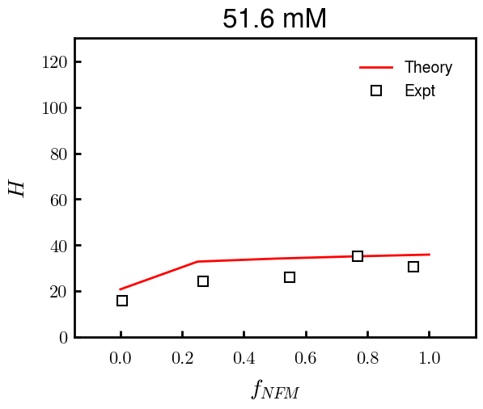
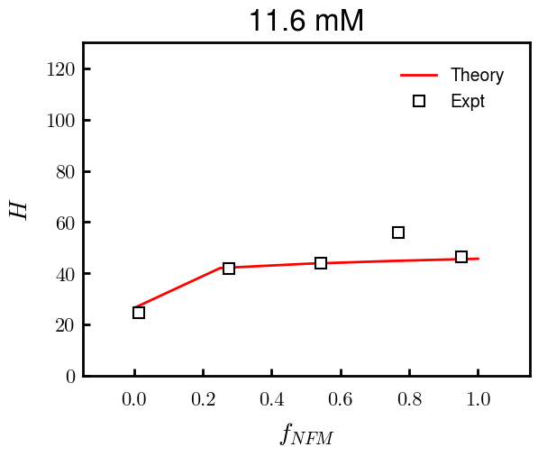
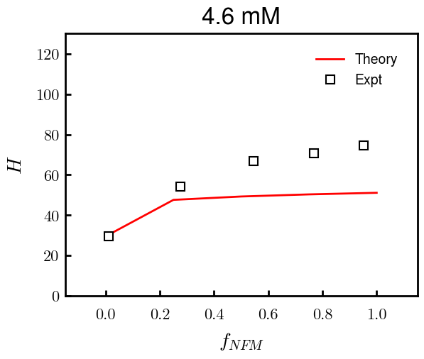
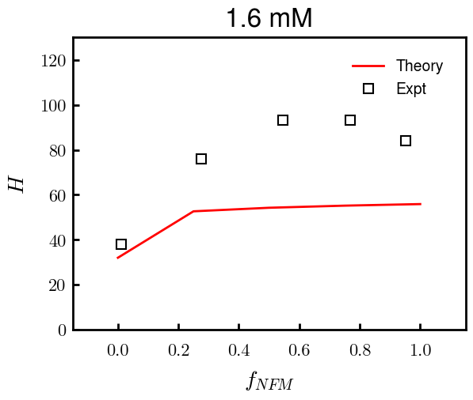
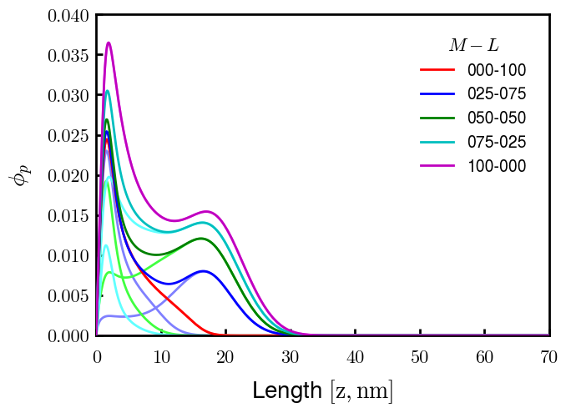
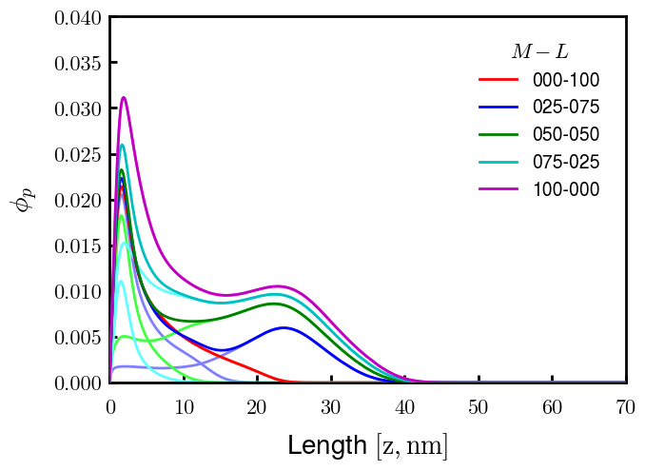
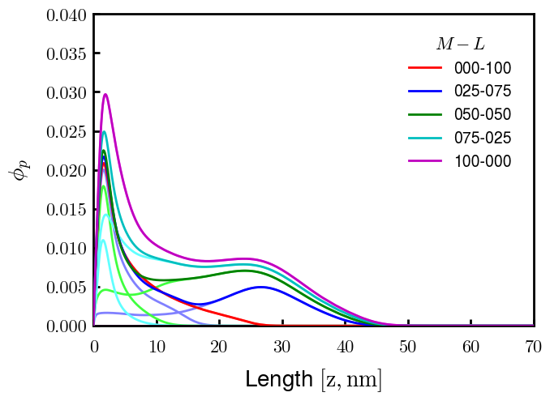
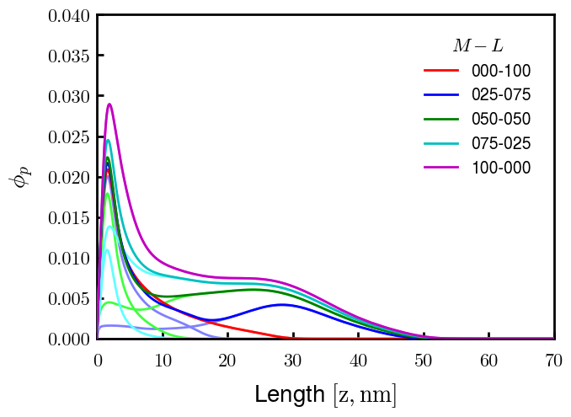
Binary NFM:NFL; sigma_total = 0.0315 c/nm2; bv = (0.6, 0.05)

Slide 4
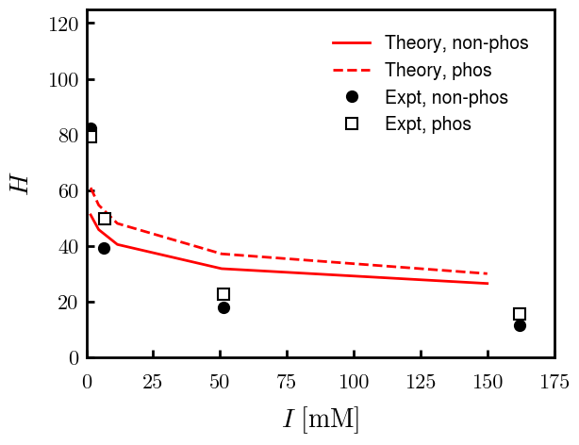
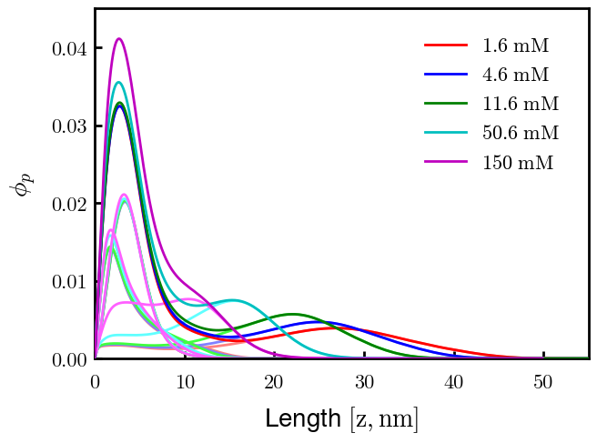
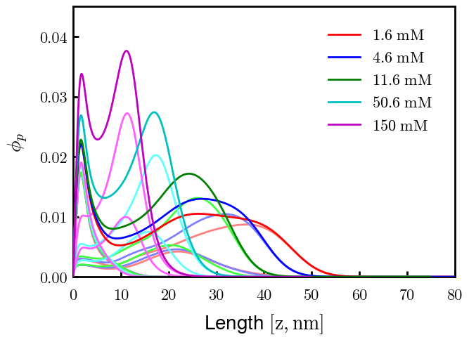
Non-phos
Phos

Slide 5
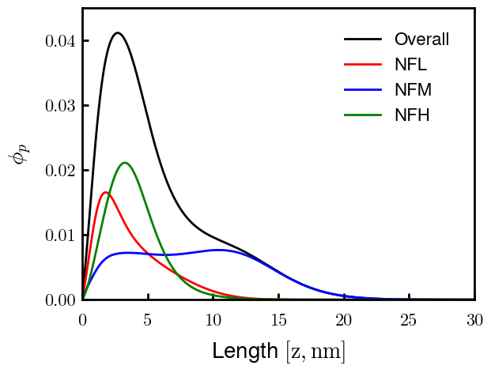
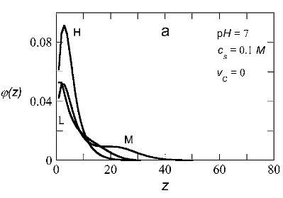
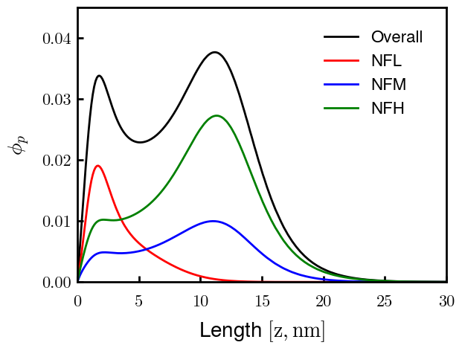
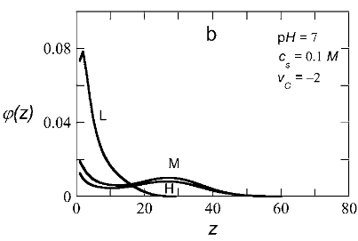
Non-phos, 0.150 M
Zhulina non-phos, 0.100 M
Phos, 0.150 M
Zhulina phos, 0.100 M

Slide 6
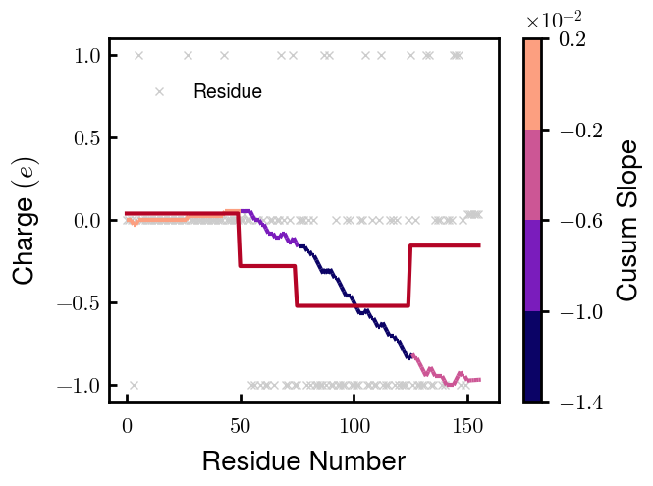
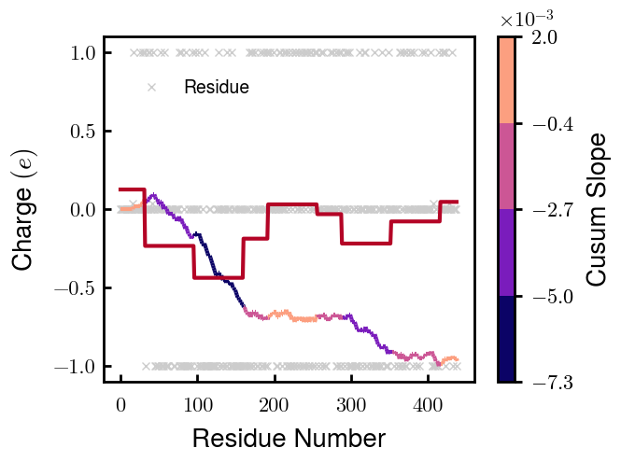

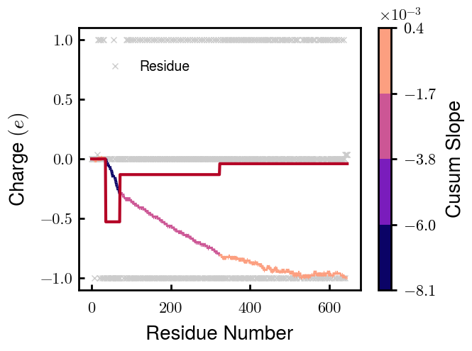
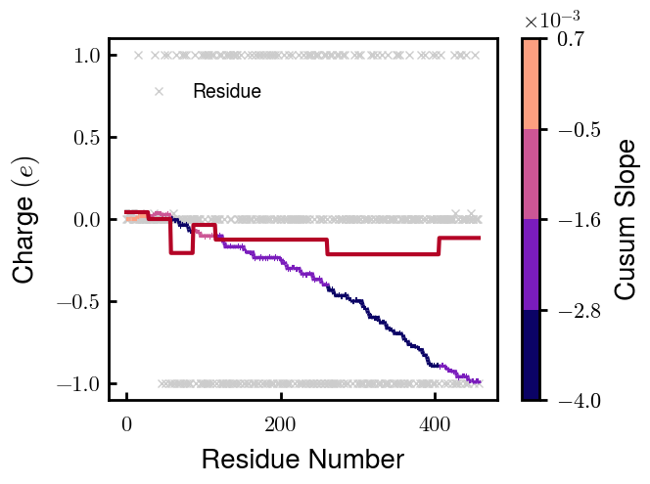
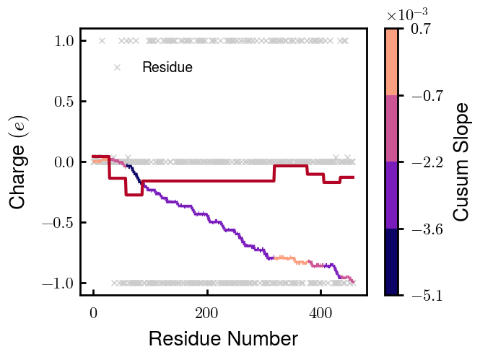
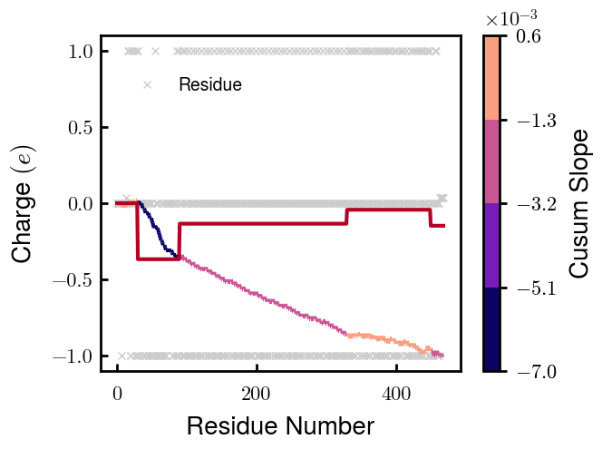
NFL
NFM
NFH
pNFH
NFM_S1
NFM_S2
pNFH_DE

Slide 7
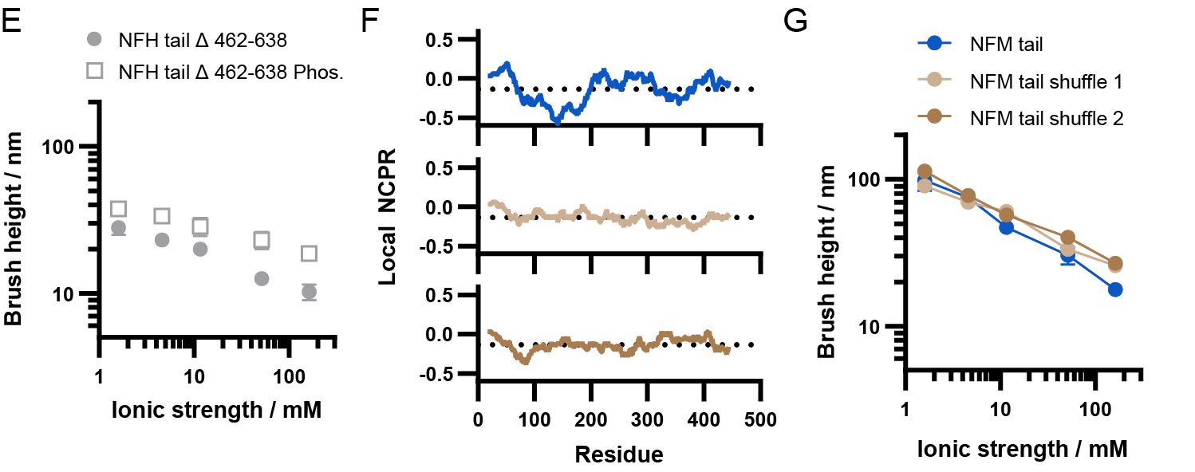
NFM_S1
NFM_S2

Slide 8
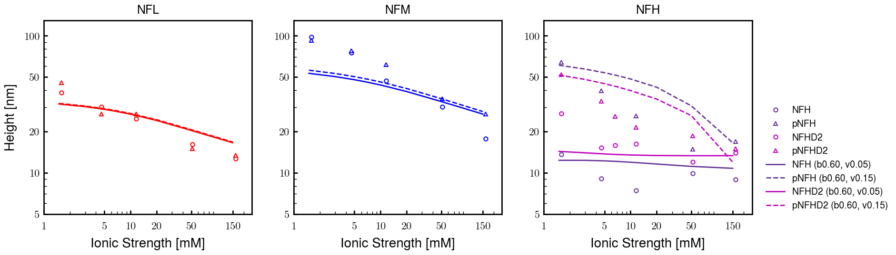
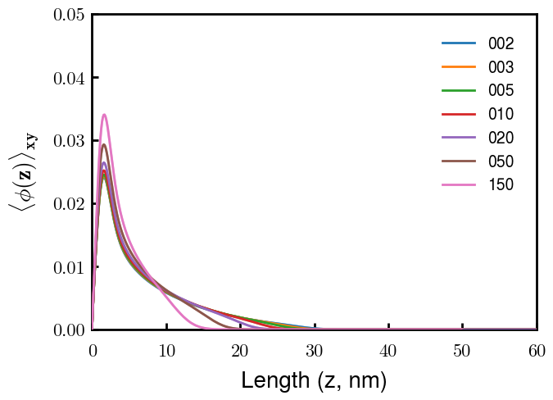
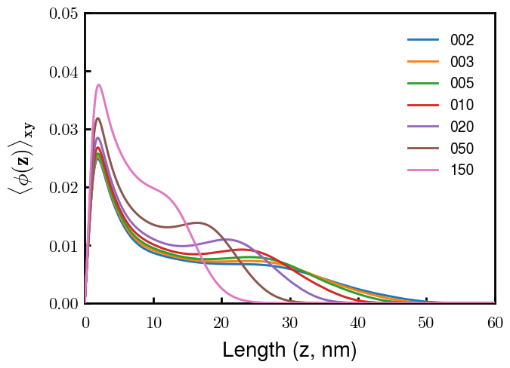
NFL
NFM
Next slide
Notes
pNFM running now; NFHb60v05c150 (cm225) running now
All non-phos same b,v
Phos L, M same as non-phos (few KsP)
Phos H 0.05 → 0.15 nm3
Potential improvements
Recheck pNFH(D2); no better option?
Recheck NFM; no better reasoning than b(s)?

Slide 9
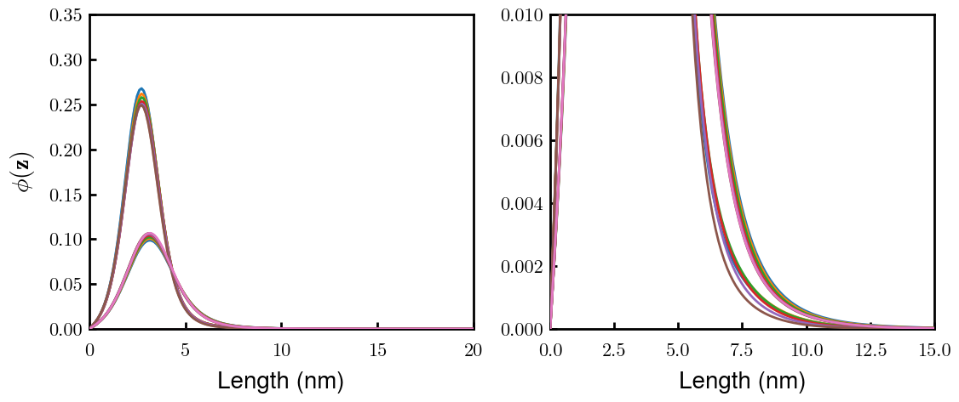
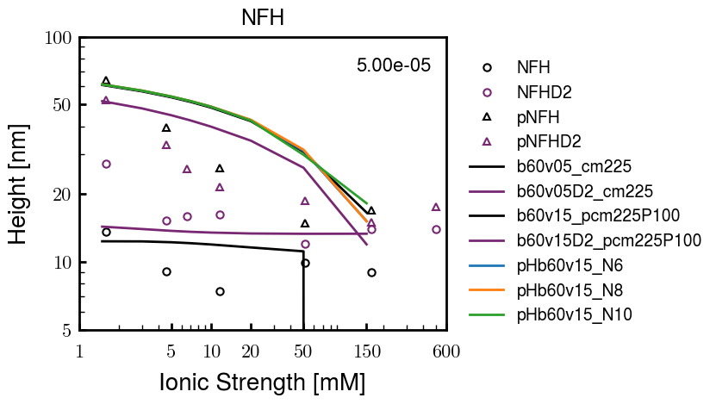
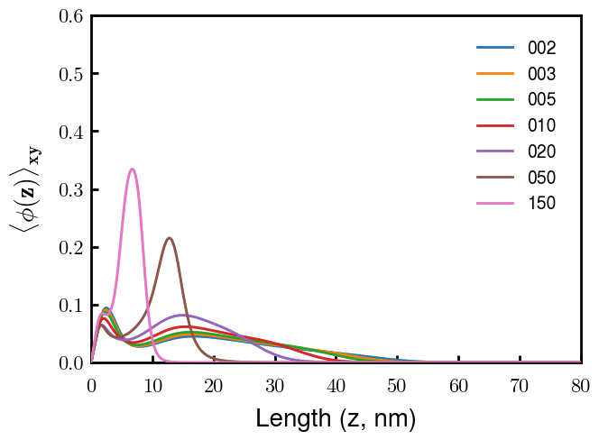
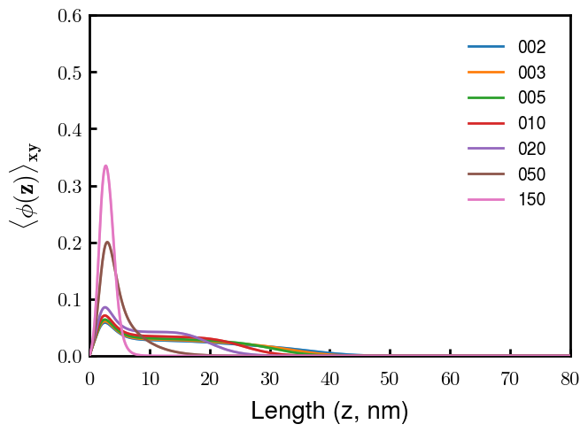
(p)NFH(D2)
NFH
NFHD2
pNFH
pNFHD2
(v = -1)
Points
v05 → v15 after phosphorylation
No condensed multilayer but worse fit

Slide 10
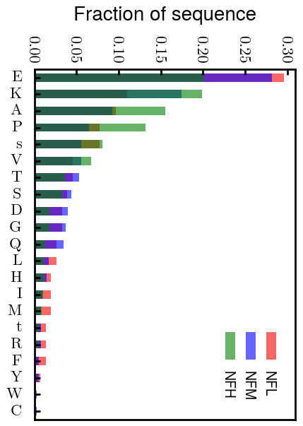
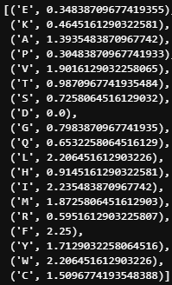
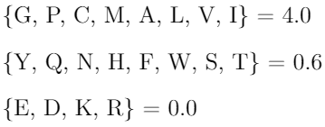
Chi (scaled)
Chi (BM 2023)
D: 3.65 (-1.00e);
E: 4.25 (-1.00e);
K: 10.53 (1.00e);
R: 12.48 (1.00e);
H: 6.00 (0.035e)
Biggest discrepancies between scaled and Zhulina: P (0.30 → 4.00), K (0.46 → 0.00), R (0.60 → 0.00)
(PKR has effect on pNFH; isolate P—currently seems too hydrophobic)

Slide 11
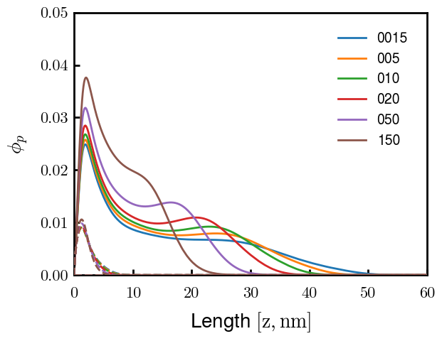
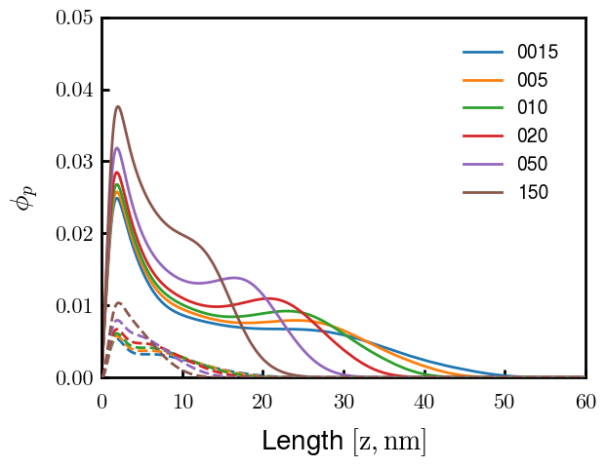
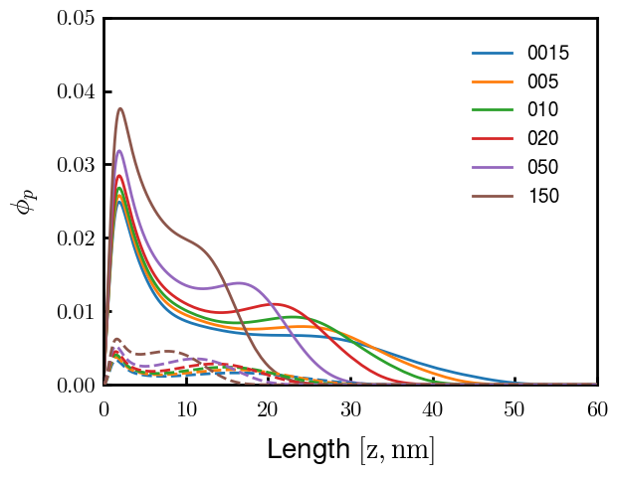






3
4
1
2
6
7
5
8
9

Slide 12



Other fits
pNFH P study next slide

Slide 13



Slide 14





pHb60v15_PKR
pHb60v15_P
pHb60v10_PKR
pHb60v10_P
PKR identified as amino acids with high discrepancies between expt and Zhulina bins
P isolated and good trend (change P to max, 2.25)
Even though better H, some conformational changes. Try to avoid by decreasing (in prog).
Single outer peak may not be bad— “flower” conf?
At the very least, increase high cs height and check NFHD2 (and eventually NFL, NFM)
Ensure effect does not ruin NFH(D2) (after screening)

Slide 15




Slide 16




Pr100

Slide 17





Slide 18


Try approaching surface

Slide 19



NFH (original); 31, 4
NFHD2; 40, 4
D2: delete 36-72
Rerun alg on D2
NFH (phos); 36, 4
NFHD2 (phos); 33, 4
Note: not currently doing this

Slide 20



Best fit w/ consistent chi_max
NFH
NFHD2
pNFH
(v = -1)
Points
v05 → v25 after phosphorylation
Bilayer (trilayer for 5?) pNFH morphology

Slide 21


Same params as prev. w/ diff thresh

Slide 22




Find best without multilayer
pNFH
pNFH
(v = -1)
(v = -1)
Multilayer at 20

Slide 23

Best pNFH scaling fit (no regard to realistic)
pNFH
(v = -1)
Points
v05 → v25 after phosphorylation
cm200 → cm250 after phospho
Multilayer
Phospho < native

Slide 24






Native NFH

Slide 25







NFHD2

Slide 26




pNFH(D2)
4e-03

Slide 27





1e-06
4e-03
norm
4e-03
Try to bring pNFH down → {cmXX + PXX} only choice
norm
4e-03

Slide 28




3e-04
3e-04
3e-04

Slide 29





Heights.params : b60v05 cm200
norm
1e-06
1e-05
1e-04
4e-03

Slide 30






Heights.params : b60v05 cm250
norm
ylog
norm
ylin
1e-06
1e-05
1e-04
5e-03

Slide 31




Heights.params: b60v10 cm{200, 225}
norm
1e-06
1e-05
1e-04
5e-03

Slide 32



Slide 33

 | Slope Bins 4 | Smear Count 25
Block number | Alpha w/ Henderson Hasselbalch | Chi Chi_max = 2.2
[0 50] | 0.040012 | 1.160000
[50 75] | -0.278451 | 0.720000
[75 125] | -0.519707 | 0.608000
[125 156] | -0.154453 | 0.529032

Slide 34

 | Slope Bins 4 | Smear Count 31
Block number | Alpha w/ Henderson Hasselbalch | Chi Chi_max = 2.2
[0 31] | 0.001103 | 0.922581
[31 62] | -0.386873 | 0.703226
[62 93] | -0.290146 | 0.967742
[93 496] | 0.037164 | 1.098759
[496 527] | -0.064533 | 0.819355
[527 620] | 0.010682 | 0.756989
[620 647] | -0.103326 | 0.696296

Slide 35






Previous
New

Slide 36





Slide 37


Response to stimuli given composition
Same data
Effect of composition given environment

Slide 38


NFL, pH 7.44, phos 1.5e (locs from LCMS)
Non-phos NFL
Block number | Alpha w/ Henderson Hasselbalch | Chi Chi_max = 3.2
[0 50] | 0.040012 | 1.540000
[50 75] | -0.278451 | 0.960000
[75 125] | -0.519707 | 0.868000
[125 156] | -0.154453 | 0.690323
 | Slope Bins 4 | Smear Count 25
Block number | Alpha w/ Henderson Hasselbalch | Chi Chi_max = 3.2
[0 50] | -0.019988 | 1.540000
[50 75] | -0.278451 | 0.960000
[75 125] | -0.519707 | 0.868000
[125 156] | -0.154453 | 0.690323

Slide 39

NFM, pH 7.44, phos 1.5e (locs from LCMS)
 | Slope Bins 4 | Smear Count 32
Block number | Alpha w/ Henderson Hasselbalch | Chi Chi_max = 3.0
[0 32] | 0.079143 | 1.275000
[32 64] | -0.186340 | 1.125000
[64 96] | -0.327964 | 1.181250
[96 160] | -0.460694 | 0.787500
[160 224] | -0.124999 | 1.115625
[224 288] | -0.023510 | 0.956250
[288 352] | -0.242085 | 1.003125
[352 384] | -0.031302 | 1.125000
[384 416] | -0.123860 | 1.050000
[416 438] | 0.046945 | 1.281818

Slide 40





Bin 3 NFM, pH 7.44, phos 1.5e (locs from LCMS)

Slide 41




Bin 5 NFM, pH 7.44, phos 1.5e (locs from LCMS)

Slide 42



Phos 2 NFM, pH 7.44, phos 2.0e (locs from LCMS)

Slide 43



Chi 2.5 NFM, pH 7.44, phos 2.0e (locs from LCMS)

Slide 44



NFM, pH 7.44, non-phos

Slide 45


NFH, pH 7.44, phos 1.5e (locs from LCMS)
 | Slope Bins 4 | Smear Count 36
Block number | Alpha w/ Henderson Hasselbalch | Chi Chi_max = 3.2 | Chi Chi_max = 3.0
[0 36] | 0.000945 | 1.266667 | 1.20000
[36 72] | -0.527455 | 0.900000 | 0.85000
[72 324] | -0.208376 | 1.729365 | 1.628571
[324 396] | -0.111195 | 1.416667 | 1.333333
[396 432] | -0.152824 | 1.344444 | 1.266667
[432 647] | -0.033955 | 1.077209 | 1.015814

Slide 46




Phos block dashed
Phos block dashed

Slide 47



Best are b3.0 v2.0 and b3.0 v3.0, but max H not high enough
Possible solutions:
Lower chi_max
Change aa_disc to have more charge
Force spectra?
Better for low salt, but high salt will melt brushes together

Slide 48



M1
pMx5

Slide 49



b3.00; v1, 2
b4.00; v2, 2.5, 3, 5, 10
b5.00; v3, 10, 15, 40
53 Nk
39 Nk
32 Nk

Slide 50
Binary results

Slide 51



Matrix Approach
Updated 04/04/2023

Slide 52














H Vol decrease (by v)
H Vol decrease (by b)
Desired “linearity” by tuning /thresh/ based on polymer density of expelled NFL
L Vol decrease (by b)
Comes at severe cost of overall height. Have to minimize outer concentration to approach pure thresh of 1e-06

Slide 53














H Vol decrease (by v)
H Vol decrease (by b)
Chimax 3.5
Desired “linearity” by tuning /thresh/ based on polymer density of expelled NFL
L Vol decrease (by b)
Comes at severe cost of overall height. Have to minimize outer concentration to approach pure thresh of 1e-06

Slide 54








F (3.5)
Chimax 3.5
Chimax 3.0
Scaled by 1.5
Scaled by 1.6
Scaled by 1.6
Scaled by 1.5
Scaled by 1.5
Scaled by 1.5
Scaled by 1.8
Scaled by 1.8

Slide 55
















Last test: same stiffness factor (b^3/v0) but with varying total volume

Slide 56












H Vol decrease (by v)
H Vol decrease (by b)
a2C_30
a2D_30
a2E_30
Rerun for Cs
b1C_30
b1D_30
b1E_30
L Vol decrease (by b)
a1C_30
a1D_30
a1E_30
g1C_30
g1D_30
g1E_30
Rerun for Cs

Slide 57












H Vol decrease (by v)
H Vol decrease (by b)
a2C
a2D
a2E
b1C
b1D
b1E
Block 4 (NFL end)
L Vol decrease (by b)
a1C
a1D
a1E
g1C
g1D
g1E

Slide 58









H Vol decrease (by v)
Chimax 3.5
H Vol decrease (by b)
a2C_30
a2D_30
a2E_30
b1C_30
b1D_30
b1E_30
L Vol decrease (by b)
a1C_30
a1D_30
a1E_30
g1C_30
g1D_30
g1E_30

Slide 59







For i as L and H:
Pure height profiles
Mixed height profiles
Current L library
Current H library
Skip; marginal increase in vol prob not enough
Move onto chi3.0; larger NFL vol library

Slide 60





NFL
All plotting wrong L pure; look only at purp
NFH
H volume too low to neutralize L (v = 31 nm3/c)

Slide 61







H volume v = 60 nm3/c

Slide 62







H volume too low to neutralize L

Slide 63










NFH, V = 70
L30

Slide 64





NFH & NFL v = 0.15
a2D
b1D
g1D

Slide 65





Based on NFH b5v15c3, apply VL = VH
NFL and NFH are from same amino acids but diff chain lengths. Should VL = VH?
L30 / H70
L80 / H20
L30 / H70
L80 / H20

Slide 66






L30 / H70
L80 / H20
L30 / H70
L80 / H20

Slide 67
L Fitting

Slide 68


VL = VH

Slide 69







Try b change, v same as H (0.15)
Phi unrealistic (?)
Phi unrealistic
Phi very unrealistic
Phi very unrealistic

Slide 70






Try similar params to H
5.6
11.2
16.8
28
56
7.5
11.25
18.75

Slide 71







Try similar params to H, b0.36
7.8
15.6
23.4
31.2
Unrealistic vol
Not very sensitive to v; not high enough to intersect neighboring chains (function of b and sigma)

Slide 72


Continuation from prev params

Slide 73







v2.7 and some fine
b1.50 v2.7 c3.2
b1.75 v2.7 c3.2
b1.75 v2.5 c3.2
b1.75 v2.5 c3.0
b2.0 v2.7 c3.2
b2.25 v2.7 c3.2
b2.50 v2.7 c3.2
Phi too small to decrease v0

Slide 74










b2.0 v10.0 c3.0
b2.0 v8.0 c3.0
b2.0 v6.0 c3.0
b2.0 v4.0 c3.0
b2.0 v2.0 c3.0
Phi limit
b1.8 v10.0 c3.0
b1.8 v8.0 c3.0
b1.8 v6.0 c3.0
b1.8 v3.0 c3.0
b1.8 v2.0 c3.0
Phi limit

Slide 75





b1.6 v10.0 c3.0
b1.6 v8.0 c3.0
b1.6 v6.0 c3.0
b1.6 v2.0 c3.0
b1.6 v1.5 c3.0
Phi limit

Slide 76









b2.0 v2.7 c3.2
b3.0 v3.5 c3.5
b3.0 v7.0 c3.5
b3.0 v7.0 c3.0
Phi too small
Phi too small to decrease v0
b4.0 v12.0 c3.0
b5.0 v20.0 c3.0
b5.0 v20.0 c4.0
b5.0 v5.0 c3.0
b5.0 v10.0 c3.0
Phi too small to decrease v0

Slide 77





v20
b5.0 v20.0 c3.0
b4.5 v20.0 c3.0
b4.0 v20.0 c3.0
b3.5 v20.0 c3.0
v10
b5.0 v10.0 c3.0
b4.0 v10.0 c3.0
b3.0 v10.0 c3.0
b2.0 v10.0 c3.0

Slide 78




b2.00 v2.70 c3.20
b2.00 v2.75 c3.20

Slide 79
NFH fitting (from NFL best fit)

Slide 80








b1.00, v0.50, c3.2
b2.00, v4.00, c3.2, th2.5e-02
b1.00, v2.00, c3.2
b1.00, v1.00, c3.2

Slide 81
Mixture

Slide 82



Slide 83


b = 0.75

Slide 84





Slide 85
b = 1.0

Slide 86





Slide 87
b = 1.25

Slide 88




Chi 2.6
Bad vol frac

Slide 89








b25v0
b25v1
b25v2
b25v3

Slide 90




Chi 2.8
Bad vol frac

Slide 91





Slide 92
b = 1.50

Slide 93






Chi 2.8
Bad vol frac

Slide 94





Slide 95

b = 2.00
v4 = 0.25*b^3

Slide 96


Bad vol frac

Slide 97



Slide 98
Fine tune

Slide 99



b1.25, v1.95, c3.0
b1.50, v3.38, c3.0
b2.00, v4.00, c3.0
Norm seems to capture kinked behavior

Slide 100




Slide 101



b1.25, v1.95, c3.2
b1.50, v3.38, c3.2
b2.00, v4.00, c3.2

Slide 102




Slide 103


b1.25
b1.50
b2.00
c2.8
c3.0
c3.2

